Slide 1

Department of Information Technology
NBA Accredited A.P. Shah Institute of Technology G.B.Road,Kasarvadavli, Thane(W), Mumbai-400615 UNIVERSITY OF MUMBAI Academic Year 2020-2021

Slide 2
A Project Report on Fake News Detection System Submitted in partial fulfilment of the degree of Bachelor of Engineering(Sem-8)
in INFORMATION TECHNOLOGY By Abdul Samad Ansari(19104022) Ekta Gujar(19104026) Sindura Dasi(19104015) Under the Guidance of Prof. Yaminee Patil

Slide 3
1.Project Conception and Initiation

Slide 4
1.1 Objectives
To implement TF-IDF Vectorizer for automatic classification of text into positive and negative vectors.
To design the system using Passive-Aggressive algorithm in such a way that it can easily predict the false news as soon as the user enters the data.
To process the system to obtain the better accuracy results.

Slide 5
1.2 Literature Review
Paper 1: Evaluating Machine Learning algorithms for Fake News Detection by Shloka Gilda.
In this paper, the author used Bi-Gram Count Vectorizer and Probabilistic Context-Free Grammar (PCFG) to detect deceptions.
Paper 2 : Fake News Detection on Social Media: A Data Mining Perspective by Kai Shu and Amy Sliva.
This paper, proposes a general two-phase data mining framework that includes feature extraction and modeling, analyzing data sets, and confusion matrix for detecting fake news.
Paper 3: Fake News Detection using Naive Bayes classifier by Mykhailo Granik and Volodymyr Mesyura.
This article describes a simple method of fake news detection based on one of the artificial intelligence algorithms called the Naive Bayes classifier

Slide 6
1.3 Problem Definition
Fake news is a type of misleading information that misleads or deceives user.
With the growth of social media and other sources these things have become one of the major problems for online social media content providers.
The proliferation of fake news on social media and Internet is deceiving people to an extent which needs to be stopped.

Slide 7
1.4 Scope
Can be used for reducing the time required to search for a place leading to quicker decision making with respect to places to visit.
Automatic fake news detection may be done using the latest news and training the model regularly to get the best results. So this can be used as a filter to upload the news.

Slide 8
1.5 Technology stack
Python 3.8 in Jupyter is used for data pre-processing, model training and prediction.
Operating System: windows 7 and above or Linux based OS or MAC OS.
HTML & CSS

Slide 9
2. Project Design

Slide 10
2.1 Proposed System
We first train a machine learning model using Passive-Aggressive classifier and TF-IDF vectorizer on a given dataset.
We use an HTML document to get a news as an input from the user.
The input is further passed to the ML model which returns whether the given news is true or false.

Slide 11
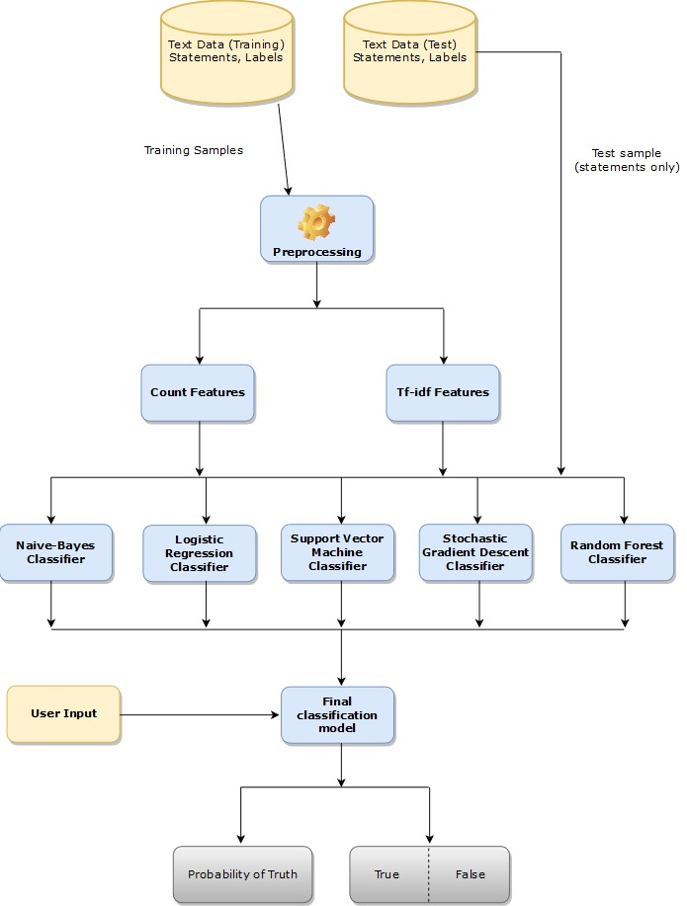
2.2 Design(Flow Of Modules)

Slide 12
3. Implementation

Slide 13

Home Page:

Slide 14

About Us:

Slide 15
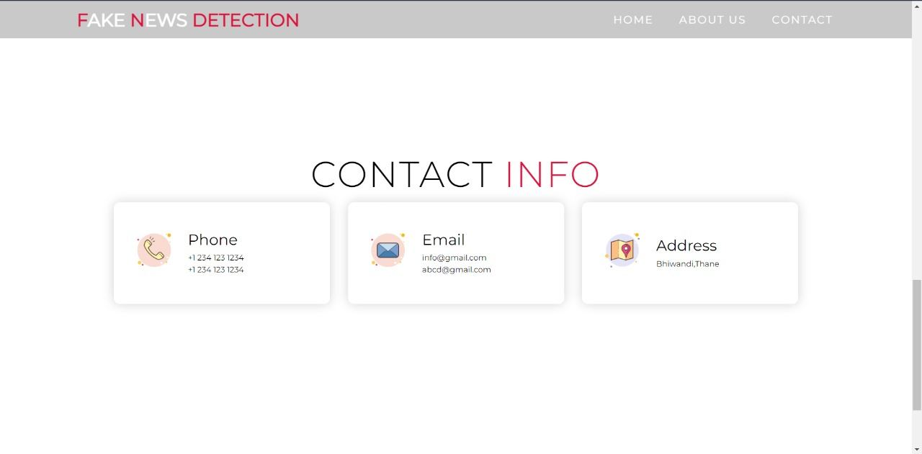
Contact Page

Slide 16

Prediction Page

Slide 17
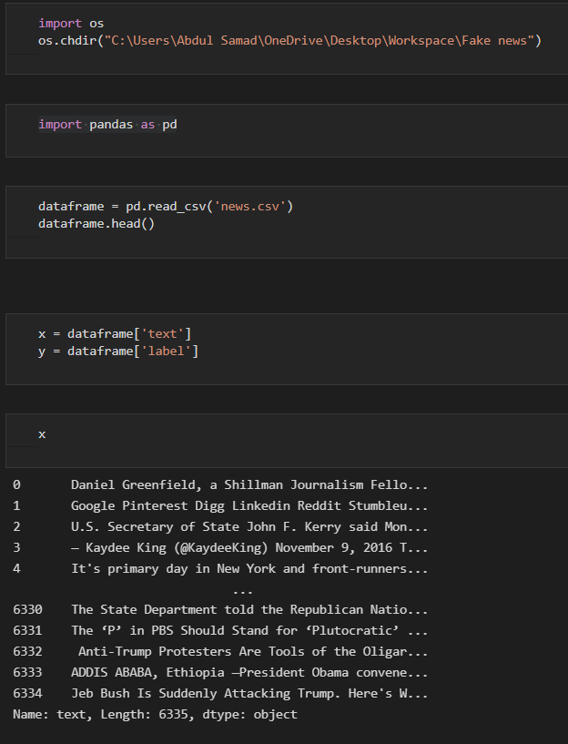
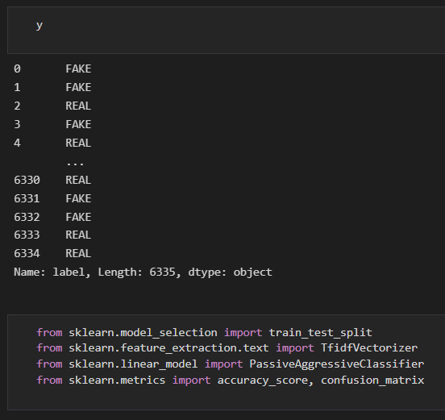

Slide 18
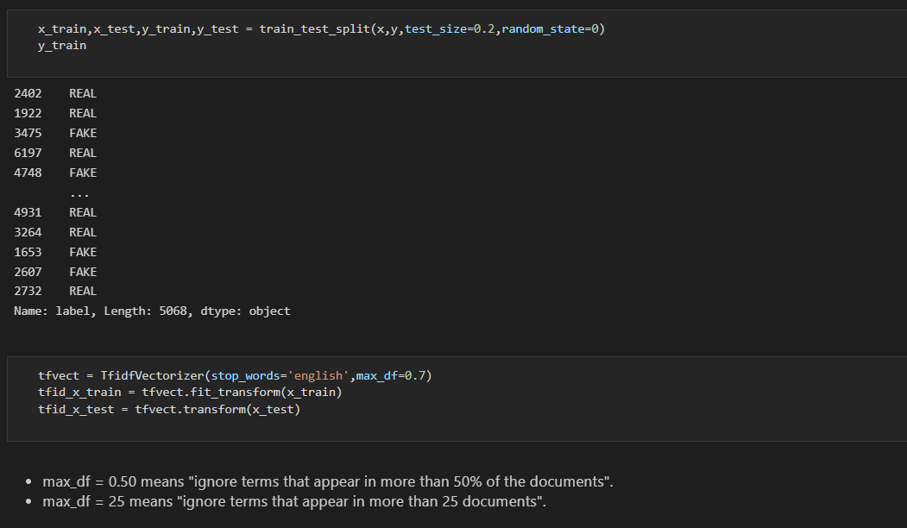

Slide 19
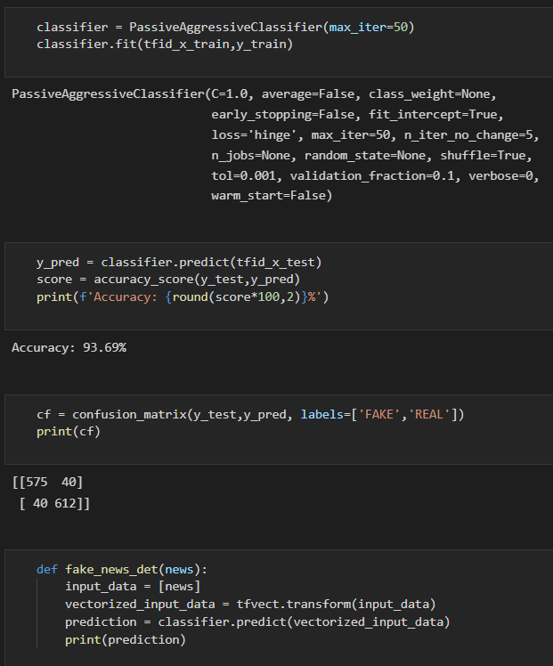
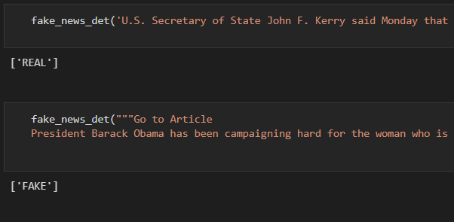

Slide 20
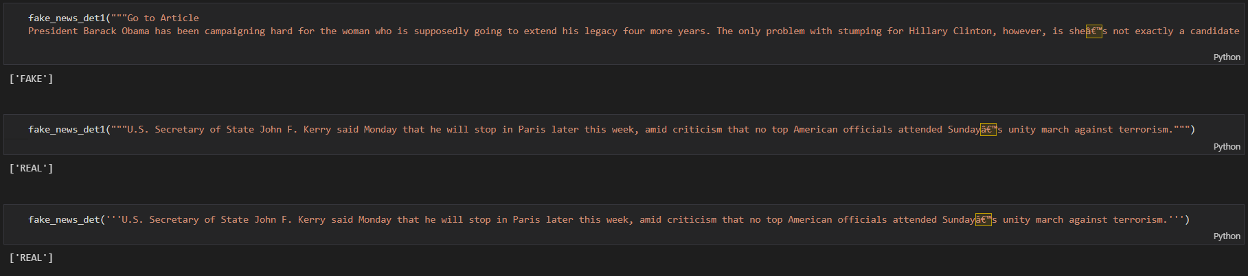

Slide 21
4. Result

Slide 22
Result
Using Passive Aggressive classifier we have created a model that can classify a news as fake or real.
User can enter a news and get prediction of whether the entered news is true or fake by the system.

Slide 23
6. Conclusion and Future Scope

Slide 24
Conclusion
Thus a machine learning model and a website has been created to verify the authenticity of a news.
With the help of Machine Learning we have created prediction model which gives the accuracy above 90%.

Slide 25
Future Scope
This project can be further enhanced to provide greater flexibility and performance with certain modification whenever necessary.
Deep fake learning which can be help to detect fake image .
Deep learning machine learning to get more accurate result.

Slide 26
References
https://www.geeksforgeeks.org/passive-aggressive-classifiers/
https://www.geeksforgeeks.org/what-is-reinforcement-learning/
https://www.tutorialspoint.com/flask/index.html

Slide 27
Thank You

